Slide 1
A 4th Party Logistics Problem Optimizer
You can write unit / affiliation. leave blank if not applicable. To change content go to: Menu → Insert (Mac = Display) → Header and Footer
Master of Science defense by
Preben Bucher Johannessen
Notes:
Introduce yourself – make a joke about the amount of people if many, or the size of the room if big..
Thesis: Mathematical model of a problem from a company called 4flow,
Created an instance generator for problem
And a solution method – metaheuristic framework
Through statistical experiments I refined this framework
In the end compared the results with a benchmark created in AMPL implementation of the mathematical model.
If I lost a few of you there, you can now leave.. dont worry I will expalin everything as we og through it.

Slide 2
Agenda
Motivation of thesis
Problem Description
A 4th Party Logistics Optimizer
Experimental Results
Conclusions
Notes:
Agenda for the presentation of my Thesis
First up is motivation, where I will present the reasons why the reasearch I made is important
Then I try to illustrate why this problem is different than a standard prickup and delivery problem by looking at some key aspects of the mathematical model. IF you enjoy math you can look forward to this part.
4PLO is what I chose to call the solution method and we’ll og through the most important parts of that.
Experimental Results will take us on a statistical journey which will lead us to a final composition of the 4PLO model and present the results of running the final model.
Before I will conclude and talk about the contributions of my thesis.

Slide 3
Agenda
Motivation of Thesis
Problem Description
A 4th Party Logistics Optimizer
Experimental Results
Conclusions
Motivation → Problem → 4PLO → Experiments → Conclusions

Slide 4
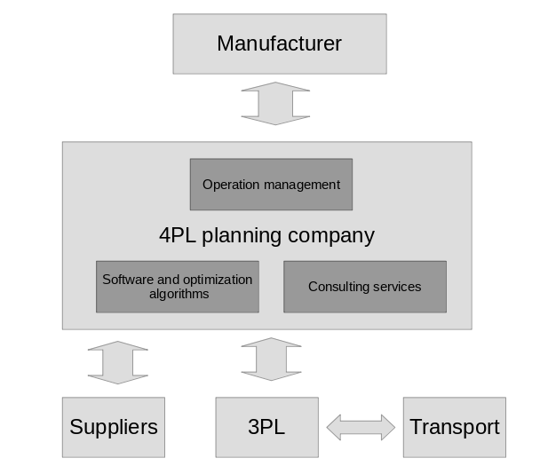
Motivation of Thesis
4flow AG – A 4th Party Logistics Company
Motivation → Problem → 4PLO → Experiments → Conclusions
Notes:
Customers: manufacturers ex. BMW
Manufacturer produces products in factories
Manufacturer is not a logistics company
Suppliers produce parts for factories
Logistic companies picks up parts from suppliers and delivers them to the factories
4flow needs to solve a Pickup and Delivery Problem
Customers have special needs

Slide 5
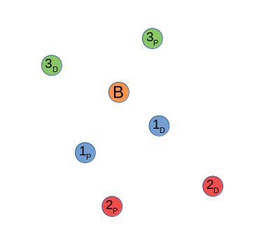
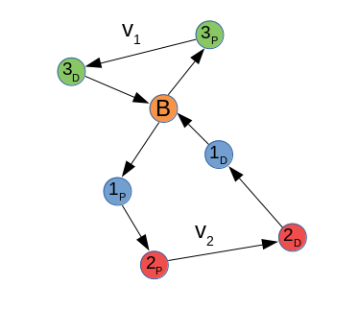
Motivation of Thesis
Pickup and Delivery Problem
Problem differences:
Variable prices based on transport
Multiple time windows
Factory dock constraints
Motivation → Problem → 4PLO → Experiments → Conclusions
Notes:
I have mentioned several times the PDP but what is it?
Well it is pretty much what the name says.
Picture you have a Base where vehicles are located.
A bunch of orders, scattered on a map accoring to a Base.
The vehicles have to pickup, deliver each order and return to base
If you have a pickup and delivery problem with timewindows each location has to be served or visited by the vehicle within the time windows
So a solution to a pickup and delivery proble could look like this.
Finding the optimal solution to these problems is very difficult and time consuming because of the amount of constraints. So in programming we call a problem like this NP-hard. Which means its compelxity has exponatial growth. For those of you I lost there aswell, Its a very hard problem to solve..
My problem differs from the standard problem in several ways. The most important ones are

Slide 6
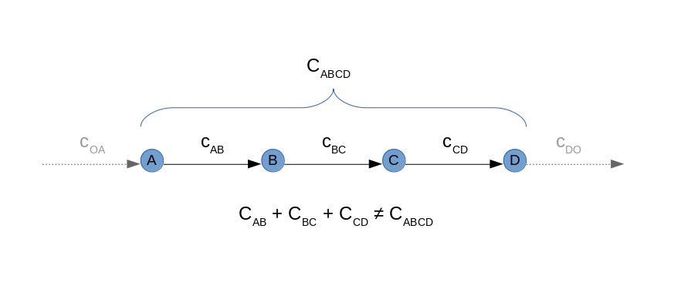
Motivation of Thesis
Variable prices based on transport
Motivation → Problem → 4PLO → Experiments → Conclusions
Notes:
Cost structure is complex.
First of all since we are a 4PL company and not a logistics company. We no longer care about the cost of a vehicle getting from origin or base to the first pickup.
This also goes for returning to base or origin.
I need to transport something from A to B. And the transport comapny wil return with a price
This price might be different for each transport company based on different parameters.
This could be KM KG Fix cost, stop cost, or any combination of these.
The result of this, is illustrated by this figure, the cost from AB + the cost of BC is not the same as ABC.
This Changes the model tremendously from the standard pickup and delivery problem. And I will also illustrate this with math in the next section.

Slide 7
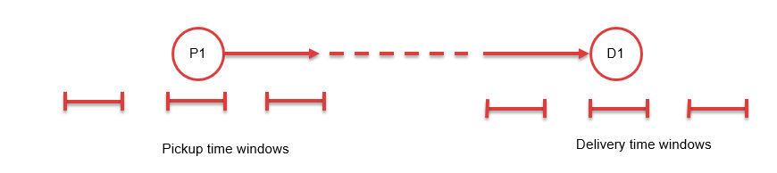
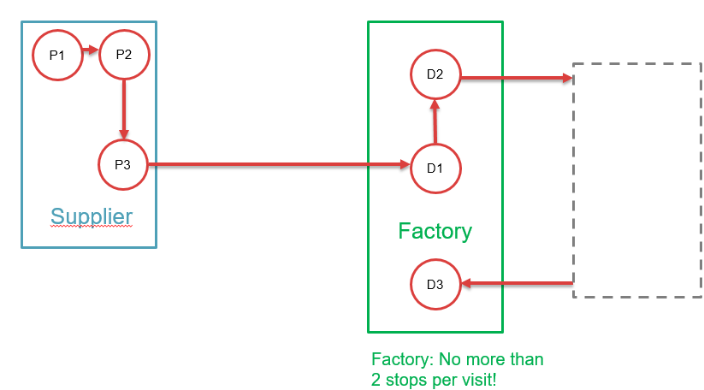
Motivation of Thesis
Multiple time windows
Factory dock constraint
Motivation → Problem → 4PLO → Experiments → Conclusions
Notes:
Multiple time windows is what it says. A Real problem is never linear and a 4PL company needs to satisfy many needs, some from the supplier, some from the manufacturer.
Then you have another aspect which is coming from the manufaturer. Lets say BMW has a huge factory area where i3 is produced and need certain part delivered. And x7 is produced over here, they need other parts.
Image this on a larger scale and you have vehicles coming in all day driving around getting lost on this huge maze of a BMW factory area. This might impose problems and traffic, cars getting lost etc.

Slide 8
Motivation of Thesis
Literary history of Pickup and Delivery Problems:
Travelling Salesman Problem, Dantzig and Ramser (1957)
Vehicle Routing Problem, Lenstra and Kahn (1981)
Pickup and Delivery Problem, Desrosiers et al. (1986), Savelsbergh and Sol (1995)
Pickup and Delivery Problem with Time Windows, Dumas et al. (1991)
Pickup and Delivery Problem with Multiple Time Windows, Favaretto et al. (2007)
Solution Approaches from the literature:
Adaptive Large Neighbourhood Search for PDPTW, Ropke and Pissinger (2006)
Exact model for PDPMTW, Manier et al. (2016)
Variable Neighbourhood search for VRPMTW, Ferreira et al. (2018)
Results of review: 4PLP not widely researched
Motivation → Problem → 4PLO → Experiments → Conclusions
Notes:
This is some of the most important papers from the litterature review. Not going to bore you with the details of that now.
Basically what we found was that some of the aspects of our model, has been researched to some extent like multiple time windows,
However others we could not find any research on like docking limit and the complex cost structure.
And the model as a whole is not widely researched
So this, combined with the fact that this is a real problem faced by a real company, illustrates the importance of research surrounding this problem

Slide 9
Agenda
Motivation of Thesis
Problem Description
A 4th Party Logistics Optimizer
Experimental Results
Conclusions
Motivation → Problem → 4PLO → Experiments → Conclusions

Slide 10
Agenda
Motivation of Thesis
Problem Formulation
A 4th Party Logistics Optimizer
Experimental Results
Conclusions
Motivation → Problem → 4PLO → Experiments → Conclusions
Notes:
Going to og a little bit into the formulation of the problem mathematically, and illustrate how it is different to the standard PDP.
So I hope you remember your high school, brought your math books..

Slide 11
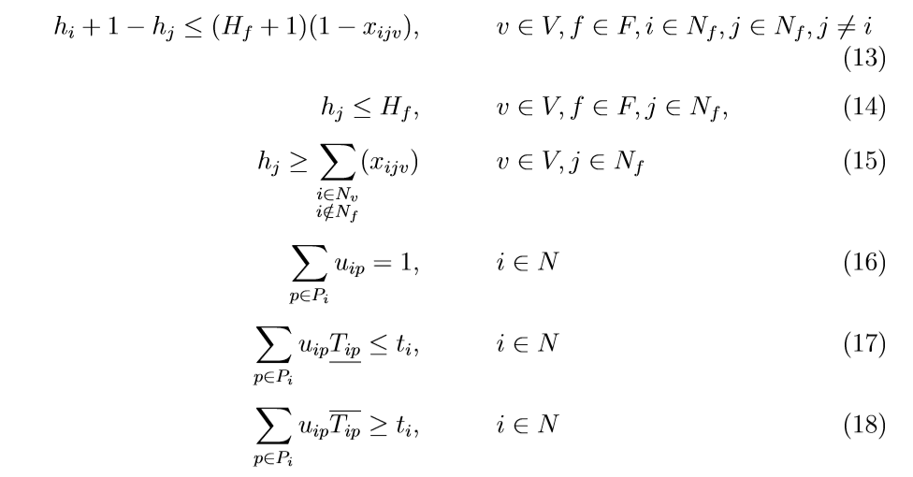
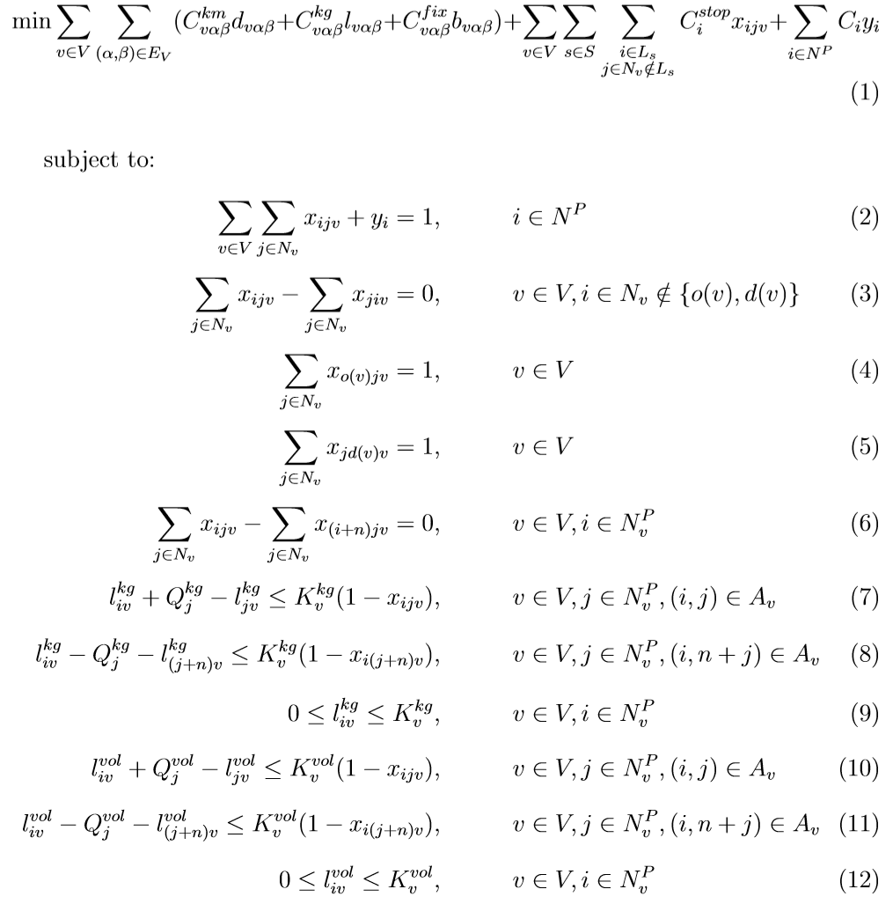
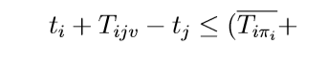
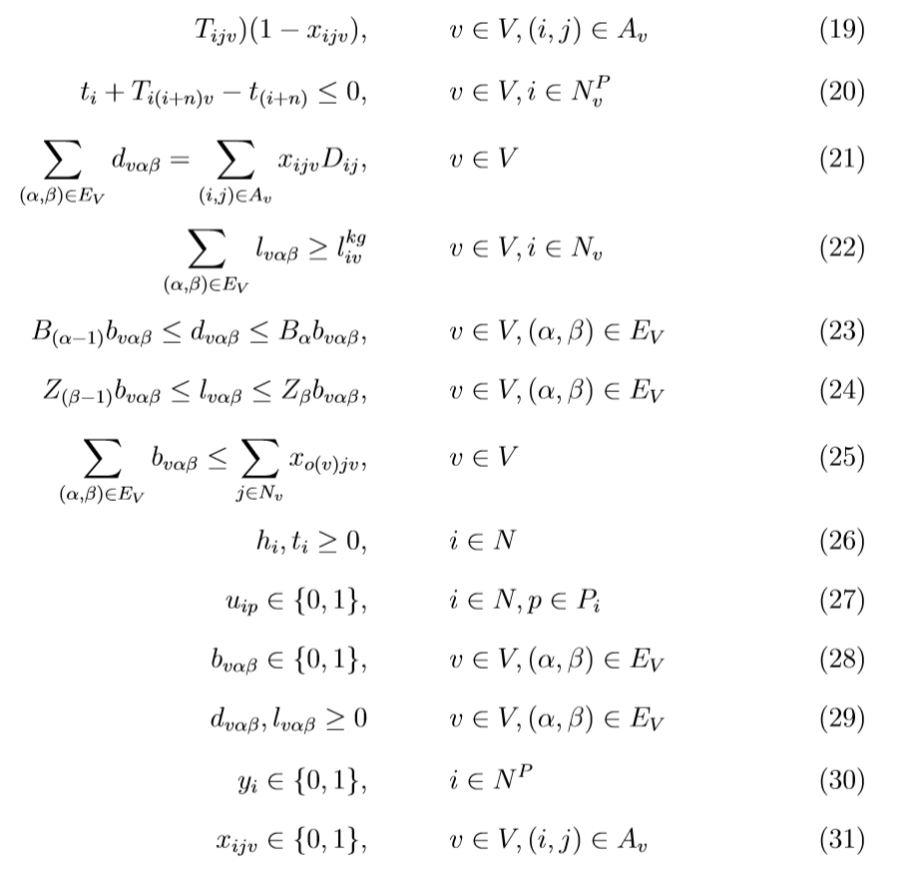
Problem Formulation
Motivation → Problem → 4PLO → Experiments → Conclusions
Notes:
We used AMPL to solve this model

Slide 12
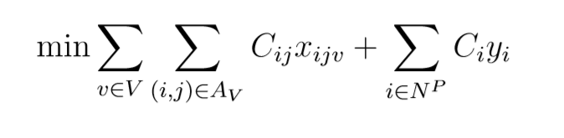
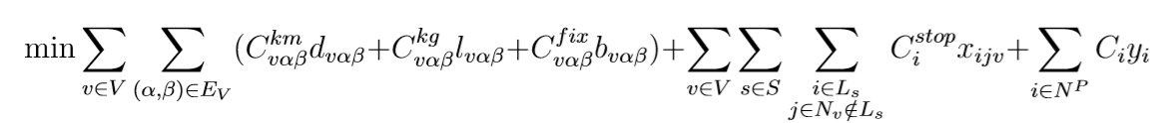
Problem Formulation
Standard Pickup and Delivery Problem objective function formulation:
4th Party Logistics Problem objective function:
Motivation → Problem → 4PLO → Experiments → Conclusions
Notes:
Standard PDP objective function, an objective function is just saying how much does it cost me in total when I solve the problem. So what does it cost me to travel between i and j, with a certain vehicle.

Slide 13
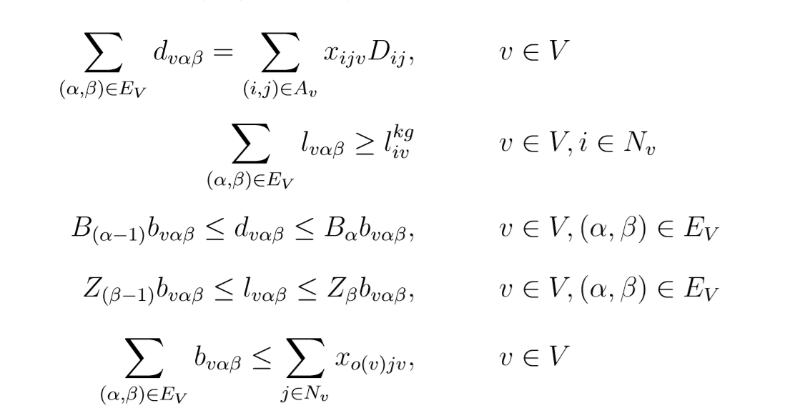
Problem Formulation
4th Party Logistics Problem cost constraints:
For a vehicle with total distance of 150 km and a maximum weight of 1500 kg the cost per km could be found as follows:
Distance/weight interval | B₁ < 100 km | B₂ < 200 km | B₃ > 200 km
Z₁ < 1000 kg | C₁₁₁^{km} = 20 | C₁₁₂^{km} = 30 | C₁₁₃^{km} = 40
Z₂ > 1000 kg | C₁₂₁^{km} = 25 | C₁₂₂^{km} = 35 | C₁₂₃^{km} = 45
Motivation → Problem → 4PLO → Experiments → Conclusions
Notes:
I am not going into details of how the constraints work but these do not exist in a stanard PDP.
I made these and it is not included in a normal model and it is making the problem much more complex.
An example is illustrated here..
Gives a total price of 350+175=525

Slide 14
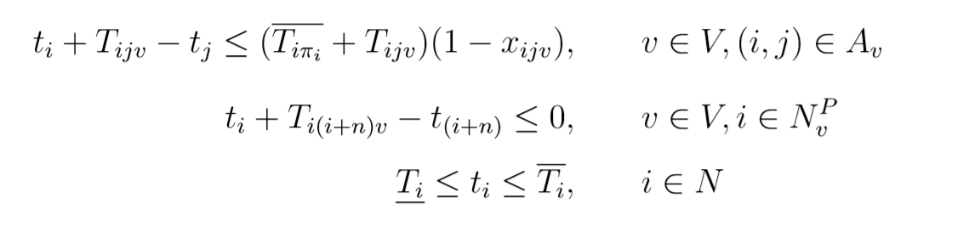
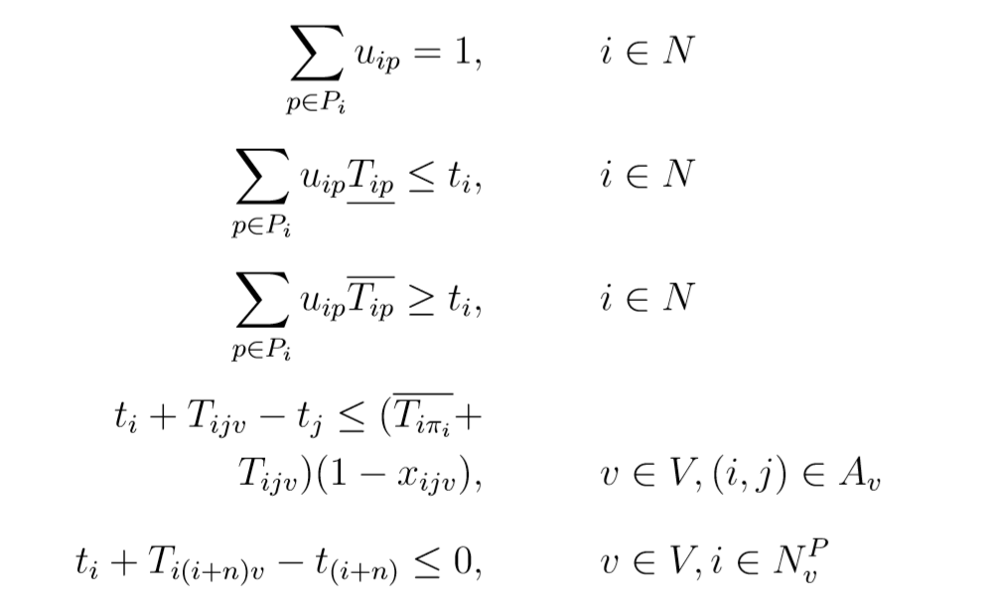
Problem Formulation
Standard Pickup and Delivery Problem with Time Windows formulation:
4th Party Logistics Problem time windows:
Motivation → Problem → 4PLO → Experiments → Conclusions

Slide 15
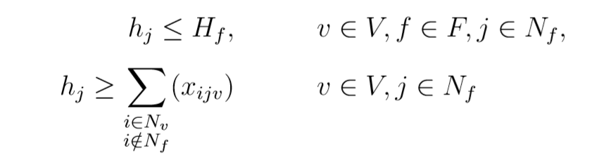
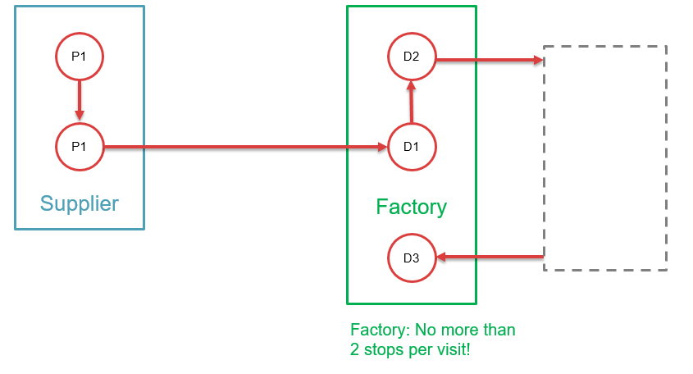
Problem Formulation
4th Party Logistics Problem factory docking constraints:
Motivation → Problem → 4PLO → Experiments → Conclusions
Notes:
The docking constraint says like I have explained that there is a limit to how many stops you can have in a factory.
These constraints are also not existing in the standard PDP.

Slide 16
Agenda
Motivation of Thesis
Problem Formulation
A 4th Party Logistics Optimizer
Experimental Results
Conclusions
Motivation → Problem → 4PLO → Experiments → Conclusions

Slide 17
Agenda
Motivation of Thesis
Problem Formulation
A 4th Party Logistics Optimizer
Experimental Results
Conclusions
Motivation → Problem → 4PLO → Experiments → Conclusions
Notes:
To solve this problem I have implemented a metaheuristic, which is a general framework that can be applied to any problem that faces the same constraints.
I called it the 4PLO or short 4PLO.

Slide 18
4th Party Logistics Optimizer
4PLO – 4th Party Logistics Optimizer
Meta-heuristic approach
Motivation → Problem → 4PLO → Experiments → Conclusions

Slide 19
4th Party Logistics Optimizer
Return Global best
Exit Loop
Generate initial solution
Yes
Are we finished?
Update heuristic selection
Enter Loop
No
Apply Wild Escape Algorithm
Are we stuck?
Accept new solution?
Update current solution
Yes
Yes
No
Select a heuristic from pool and apply it to the current solution
New global best solution?
No
Yes
Update global best
Motivation → Problem → 4PLO → Experiments → Conclusions
Notes:
So what is a meta heuristic approach?
It is a high-level problem-independent algorithmic framework.
It applies sub heuristics to a solution of the problem to move around the solution space.
The whole algorithm is a loop so we start by generating an initial solution, and then we enter the loop with this as our current solution.

Slide 20
4th Party Logistics Optimizer
Initial solution
Not transporting anything
Clean start, let heuristics do the work
Can be time consuming to find an initial solution
Motivation → Problem → 4PLO → Experiments → Conclusions

Slide 21
4th Party Logistics Optimizer
Return Global best
Exit Loop
Generate initial solution
Yes
Are we finished?
Update heuristic selection
Enter Loop
No
Apply Wild Escape Algorithm
Are we stuck?
Accept new solution?
Update current solution
Yes
Yes
No
Select a heuristic from pool and apply it to the current solution
New global best solution?
No
Yes
Update global best
Motivation → Problem → 4PLO → Experiments → Conclusions
Notes:
So what is a meta heuristic approach?
It is a high-level problem-independent algorithmic framework.
It applies sub heuristics to a solution of the problem to move around the solution space.
The whole algorithm is a loop so we start by generating an initial solution, and then we enter the loop with this as our current solution.

Slide 22
4th Party Logistics Optimizer
Heuristics
Swap
3-exchange
2-opt
Random Fit
Clustering
Greedy
Similar Regret
Motivation → Problem → 4PLO → Experiments → Conclusions

Slide 23
4th Party Logistics Optimizer
Heuristics – Swap
1_{D}
1_{D}
1_{P}
1_{P}
3_{P}
3_{D}
Swap
3_{P}
3_{D}
2_{D}
2_{D}
2_{P}
2_{P}
Vehicle schedule: ( 1 2 3 3 2 1)
( 1 3 2 2 3 1 )
Motivation → Problem → 4PLO → Experiments → Conclusions

Slide 24
4th Party Logistics Optimizer
Heuristics – Clustering
Remove orders from other clusters
Reinsert orders together in the same cluster
Motivation → Problem → 4PLO → Experiments → Conclusions

Slide 25
4th Party Logistics Optimizer
Heuristics – Clustering
Single linkage hierachical clustering
Reducing amount of clusters until size k
 | a | b | c | d
a | 0 | 9 | 6 | 7
b | 9 | 0 | 8 | 5
c | 6 | 8 | 0 | 9
d | 7 | 5 | 9 | 0
 | a | b,d | c
a | 0 | 7 | 6
b,d | 7 | 0 | 8
c | 6 | 8 | 0
 | a,c | b,d
a,c | 0 | 7
b,d | 7 | 0
Motivation → Problem → 4PLO → Experiments → Conclusions
Notes:
4 nodes, want to have 2 clusters..
It would go like this (illustration).
Always choosing the lowest distance to merge together.
But how do I determine k?

Slide 26
4th Party Logistics Optimizer
Heuristics – Clustering
Silhuette Coefficient, determining the value of cluster size k
Cohesion Separation
i
Motivation → Problem → 4PLO → Experiments → Conclusions
Notes:
Represented by these to terms:
Cohesion which is the distance from a node to all other nodes in the same cluster.
Separation distance to the clostest other cluster.
This is how I determined which locations are clustered together and this heuristic is trying to put orders from similar clusters together.

Slide 27
4th Party Logistics Optimizer
Heuristics – Clustering
Remove orders from other clusters
Reinsert orders together in the same cluster
Motivation → Problem → 4PLO → Experiments → Conclusions

Slide 28
4th Party Logistics Optimizer
Return Global best
Exit Loop
Generate initial solution
Yes
Are we finished?
Update heuristic selection
Enter Loop
No
Apply Wild Escape Algorithm
Are we stuck?
Accept new solution?
Update current solution
Yes
Yes
No
Select a heuristic from pool and apply it to the current solution
New global best solution?
No
Yes
Update global best
Motivation → Problem → 4PLO → Experiments → Conclusions
Notes:
So what is a meta heuristic approach?
It is a high-level problem-independent algorithmic framework.
It applies sub heuristics to a solution of the problem to move around the solution space.
The whole algorithm is a loop so we start by generating an initial solution, and then we enter the loop with this as our current solution.

Slide 29
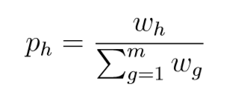
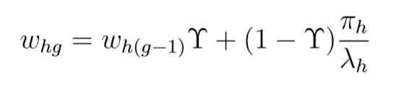
4th Party Logistics Optimizer
Selecting a heuristic
Roulette wheel principle
Adaptive weights
Heuristic score points, global best > current best > new solution
Weights adapt:
Motivation → Problem → 4PLO → Experiments → Conclusions

Slide 30
4th Party Logistics Optimizer
Return Global best
Exit Loop
Generate initial solution
Yes
Are we finished?
Update heuristic selection
Enter Loop
No
Apply Wild Escape Algorithm
Are we stuck?
Accept new solution?
Update current solution
Yes
Yes
No
Select a heuristic from pool and apply it to the current solution
New global best solution?
No
Yes
Update global best
Motivation → Problem → 4PLO → Experiments → Conclusions
Notes:
So what is a meta heuristic approach?
It is a high-level problem-independent algorithmic framework.
It applies sub heuristics to a solution of the problem to move around the solution space.
The whole algorithm is a loop so we start by generating an initial solution, and then we enter the loop with this as our current solution.

Slide 31
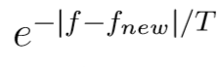
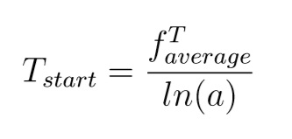
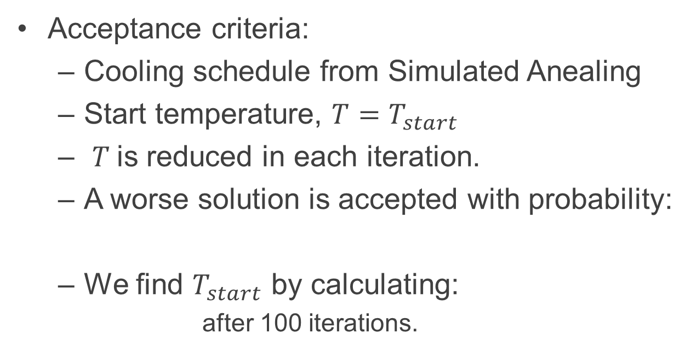
4th Party Logistics Optimizer
Acceptance criteria:
Cooling schedule from Simulated Anealing
Start temperature, ${T=T}_{start}$
$T$is reduced in each iteration.
A worse solution is accepted with probability:
We find $T_{start}$ by calculating:
after 100 iterations.
Motivation → Problem → 4PLO → Experiments → Conclusions
Notes:
Yes we could set T_start fixed.. But again we want our algorithm to adapt to each problem automatically.
¨We do this by letting our algorithm run for 100 iterations accepting worse solutions with 80% probability.
Then we calculate the average objective of these solutions and devide that with the logarithm of a

Slide 32
4th Party Logistics Optimizer
Return Global best
Exit Loop
Generate initial solution
Yes
Are we finished?
Update heuristic selection
Enter Loop
No
Apply Wild Escape Algorithm
Are we stuck?
Accept new solution?
Update current solution
Yes
Yes
No
Select a heuristic from pool and apply it to the current solution
New global best solution?
No
Yes
Update global best
Motivation → Problem → 4PLO → Experiments → Conclusions
Notes:
So what is a meta heuristic approach?
It is a high-level problem-independent algorithmic framework.
It applies sub heuristics to a solution of the problem to move around the solution space.
The whole algorithm is a loop so we start by generating an initial solution, and then we enter the loop with this as our current solution.

Slide 33
4th Party Logistics Optimizer
Escape Algorithm
Escape condition → 500 iterations without improvement
Wild Escape algorithm
Select a diversifing heuristic
Apply heuristic to solution
Accept any solution
Stop after 20 iterations
Motivation → Problem → 4PLO → Experiments → Conclusions

Slide 34
4th Party Logistics Optimizer
Return Global best
Exit Loop
Generate initial solution
Yes
Are we finished?
Update heuristic selection
Enter Loop
No
Apply Wild Escape Algorithm
Are we stuck?
Accept new solution?
Update current solution
Yes
Yes
No
Select a heuristic from pool and apply it to the current solution
New global best solution?
No
Yes
Update global best
Motivation → Problem → 4PLO → Experiments → Conclusions
Notes:
So what is a meta heuristic approach?
It is a high-level problem-independent algorithmic framework.
It applies sub heuristics to a solution of the problem to move around the solution space.
The whole algorithm is a loop so we start by generating an initial solution, and then we enter the loop with this as our current solution.

Slide 35
Agenda
Motivation of Thesis
Problem Formulation
A 4th Party Logistics Optimizer
Experimental Results
Conclusions
Motivation → Problem → 4PLO → Experiments → Conclusions

Slide 36
Agenda
Motivation of Thesis
Problem Formulation
A 4th Party Logistics Optimizer
Experimental Results
Conclusions
Motivation → Problem → 4PLO → Experiments → Conclusions

Slide 37
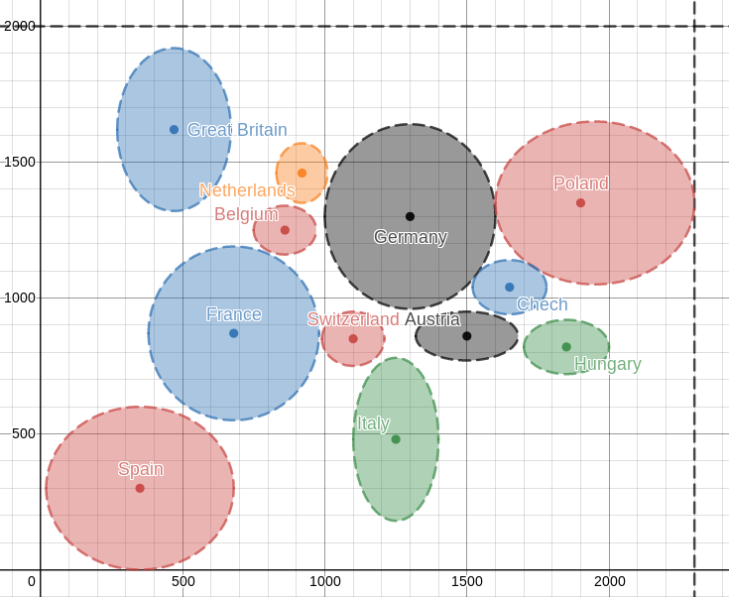
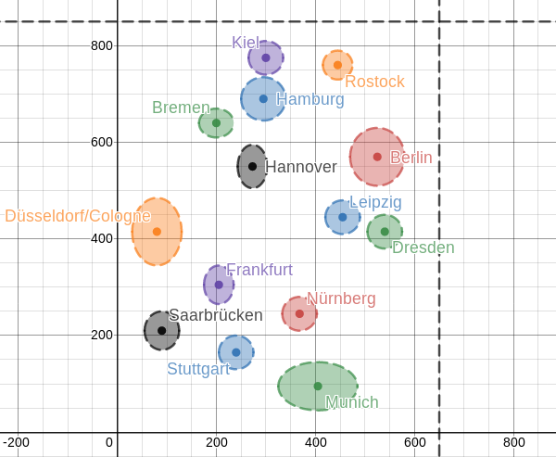
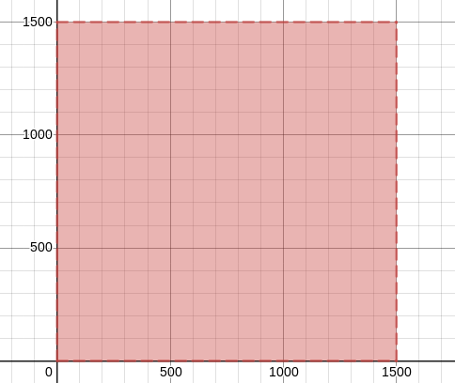
Experimental Results
Generated 5x5 instances based on real data.
Europe, Germany, Uniform location generation
Motivation → Problem → 4PLO → Experiments → Conclusions

Slide 38
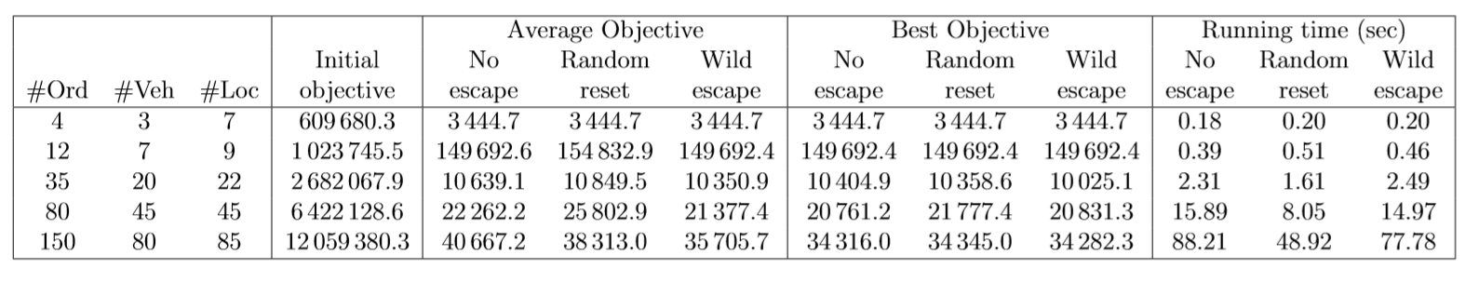
Experimental Results
Initial experiments – Escape Algorithm
Wild Escape Algorithm outperforms other escape algorithms
Motivation → Problem → 4PLO → Experiments → Conclusions
Notes:
What happens if we dont include any escape algorithm?
What happens if we start from a random solution every time we get stuck instead of moving away from the current solution?

Slide 39
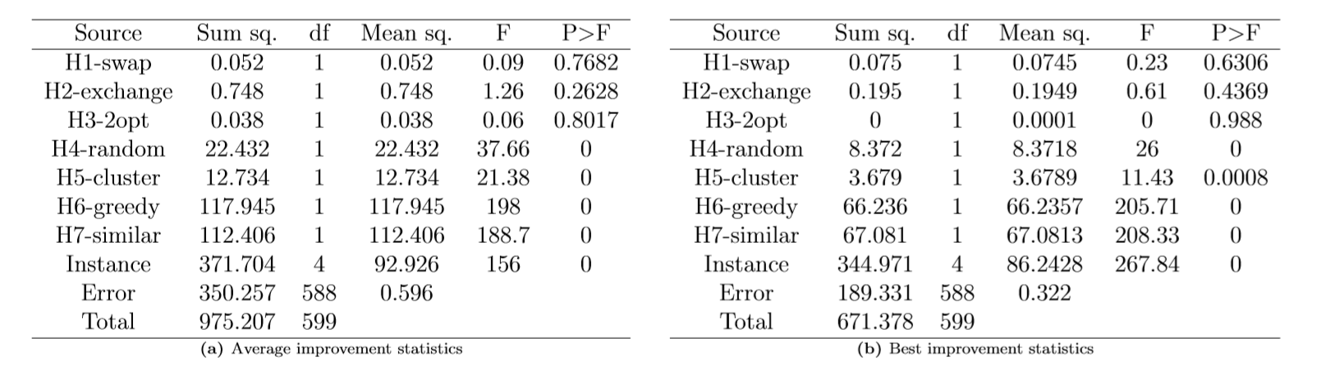
Experimental Results
Initial experiments – Heuristics
Analysis of variance ANOVA
Results: H4-H7 significant impact on the result
Motivation → Problem → 4PLO → Experiments → Conclusions

Slide 40
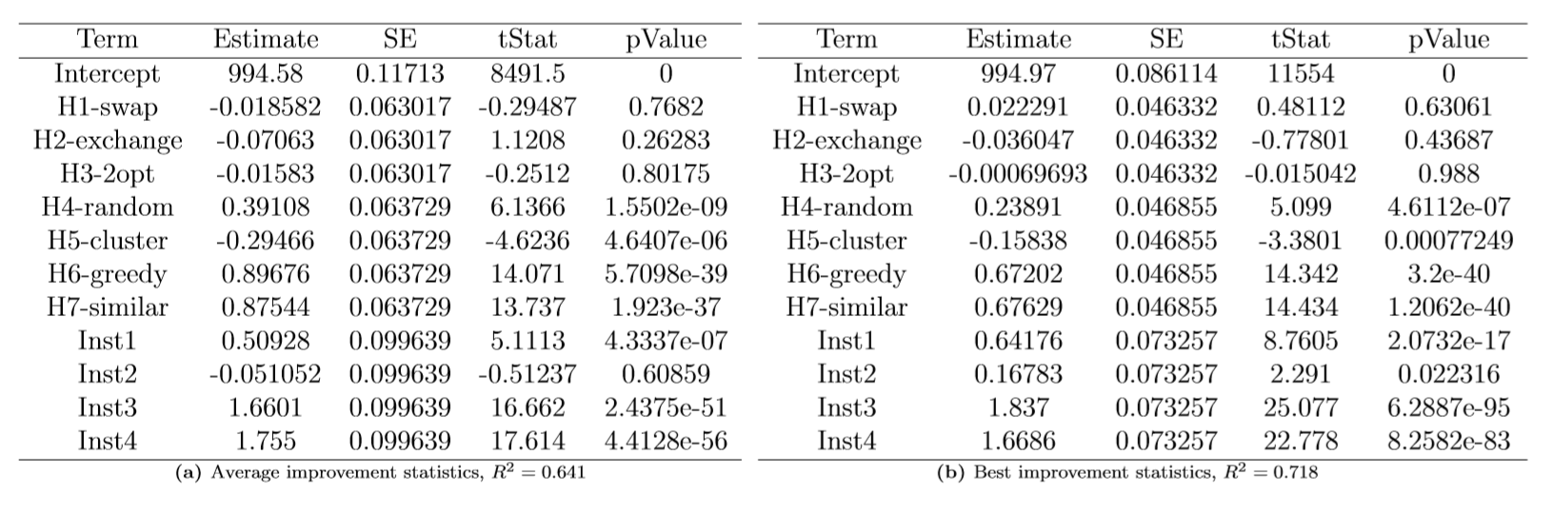
Experimental Results
Initial experiments – Heuristics
Multiple Linear Regression Model
Results: H4, H6, H7 significant positive impact
Motivation → Problem → 4PLO → Experiments → Conclusions

Slide 41
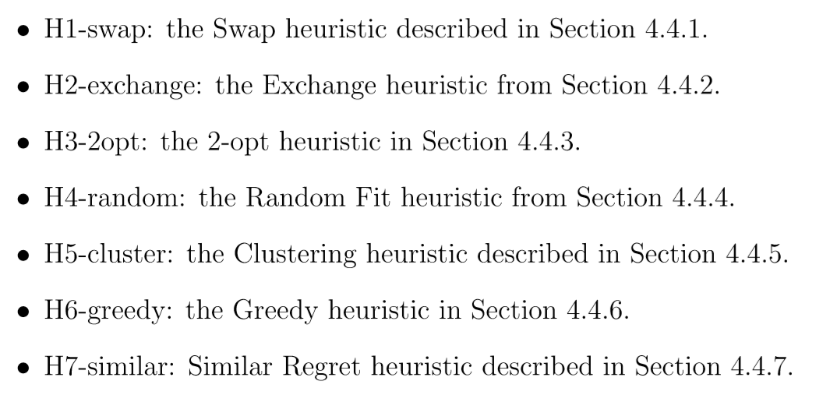
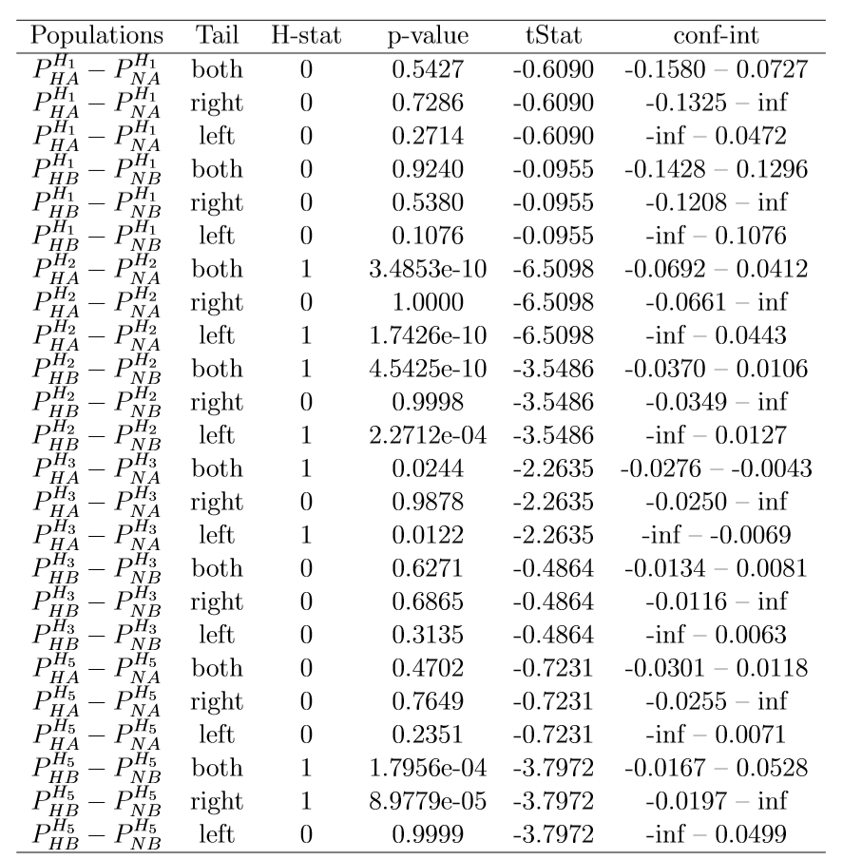
Experimental Results
Further experiments – Individual
T-tests on using heuristics H1, H2, H3 and H5 combined with at least one of H4, H6 & H7, or not
Motivation → Problem → 4PLO → Experiments → Conclusions

Slide 42
Experimental Results
Further experiments – Individual
Results:
H1-swap, no significant impact
H2-exchange, significant negative impact on result
H3-2opt, significant negative impact on average result
H5-Clustering, significant positive impact on best solution found
Motivation → Problem → 4PLO → Experiments → Conclusions

Slide 43
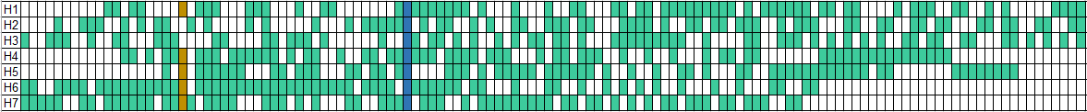
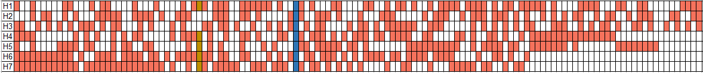
Experimental Results
Deciding on a final model
The final model contain the following components:
Wild escape algorithm + H1?, H4, H5, H6, H7
Final model in Ranking:
Motivation → Problem → 4PLO → Experiments → Conclusions

Slide 44
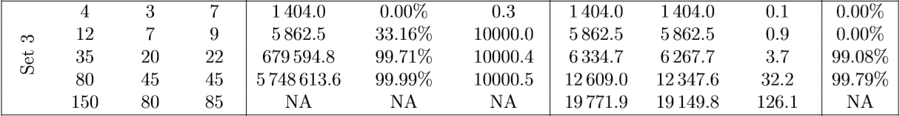
Experimental Results
Results of final model
Motivation → Problem → 4PLO → Experiments → Conclusions

Slide 45
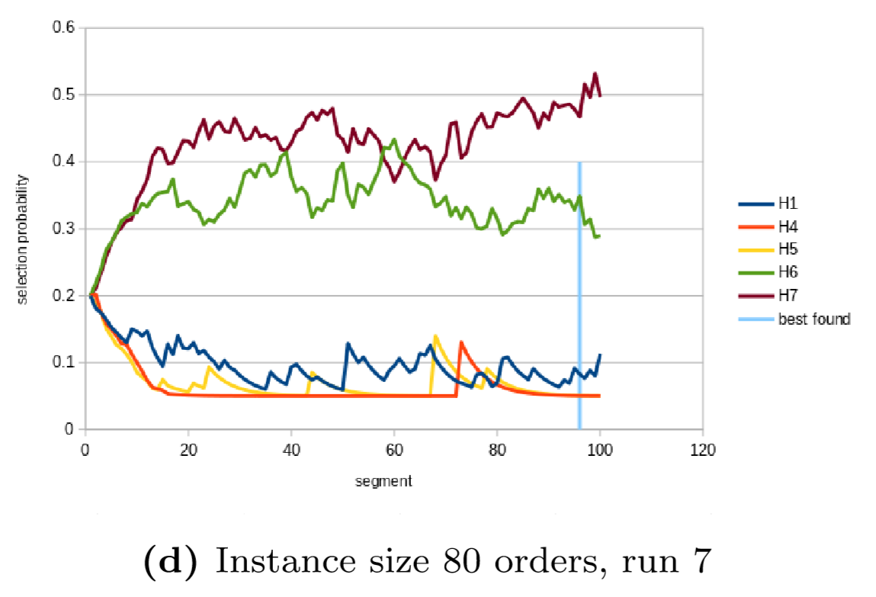
Experimental Results
Motivation → Problem → 4PLO → Experiments → Conclusions

Slide 46
Agenda
Motivation of Thesis
Problem Formulation
A 4th Party Logistics Optimizer
Experimental Results
Conclusions
Motivation → Problem → 4PLO → Experiments → Conclusions

Slide 47
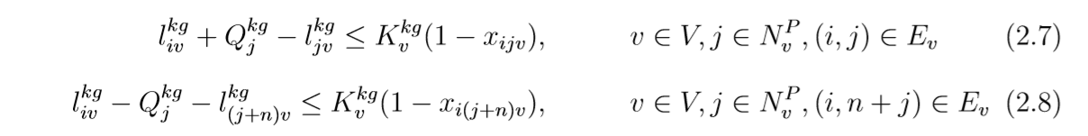
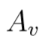
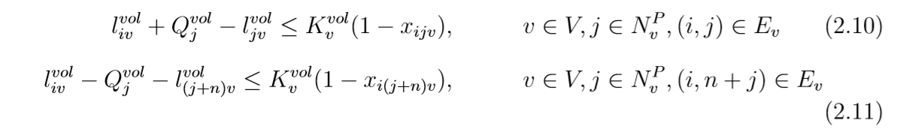
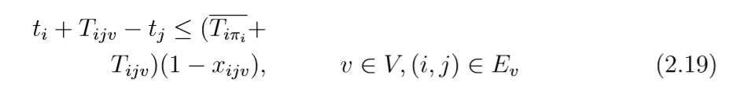
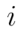
Typo’s
Page 12:
Page 13:
Page 25, Algorithm 6:
Motivation → Problem → 4PLO → Experiments → Conclusions

Slide 48
Agenda
Motivation of Thesis
Problem Formulation
A 4th Party Logistics Optimizer
Experimental Results
Conclusions
Motivation → Problem → 4PLO → Experiments → Conclusions

Slide 49
Conclusions & Contributions
4PL industry requires good solution models
Mathematical formulation of the 4PLP
Designed model, 4PLO, a meta heuristic framework to solve realistic sized instances of the problem
Experimental testing showed that the Wild Escape Algorithm and the heuristics Random Fit, Clustering, Greedy and Similar Regret had significant positive impact on result
The final model gives efficient robust solutions to varied instances
This thesis will be submitted as a paper to a journal
Thank you for your attention! Questions?
Motivation → Problem → 4PLO → Experiments → Conclusions

Slide 50


Slide 51
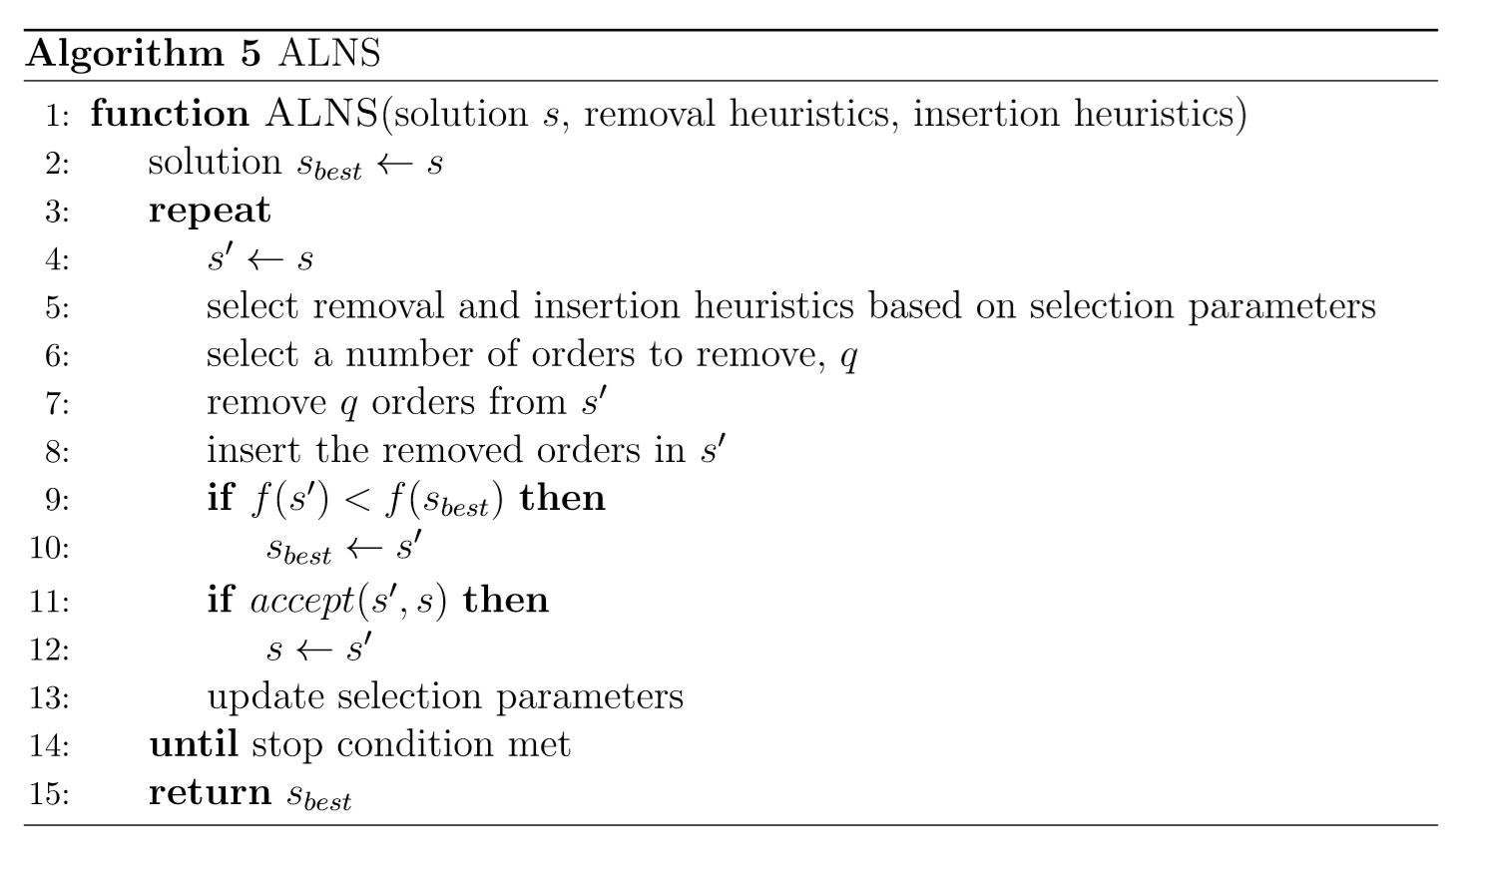
Solution Methods
Famous meta-heuristics – Adaptive Large Neighbourhood Search

Slide 52
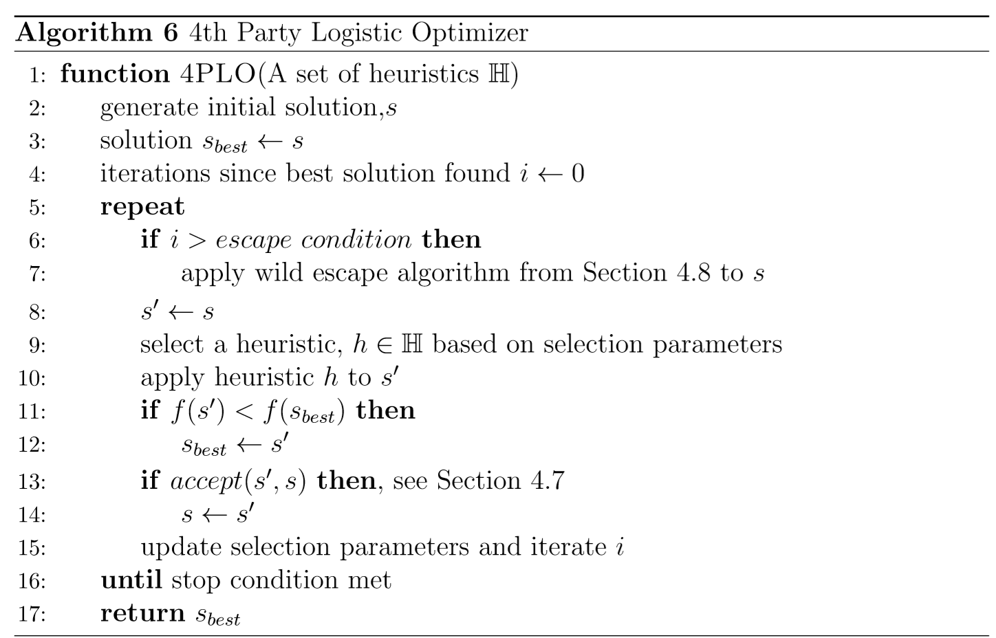
4th Party Logistics Optimizer
4PLO – 4th Party Logistics Optimizer
Meta-heuristic approach
Motivation → Problem → 4PLO → Experiments → Conclusions

Slide 53
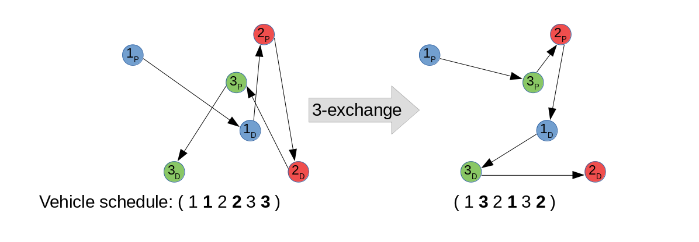
4th Party Logistics Optimizer
Heuristics – 3-exchange
Motivation → Problem → 4PLO → Experiments → Conclusions

Slide 54
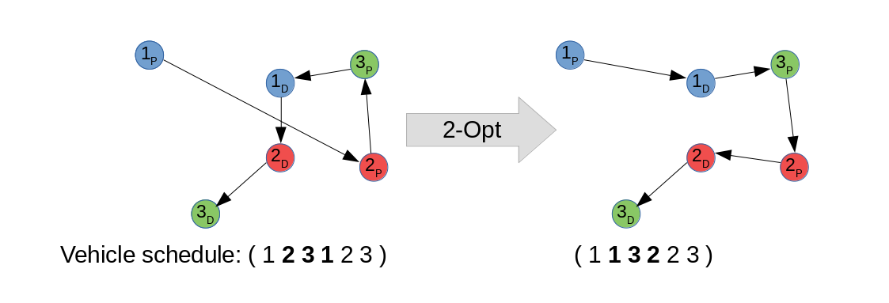
4th Party Logistics Optimizer
Heuristics – 2-opt
Motivation → Problem → 4PLO → Experiments → Conclusions

Slide 55
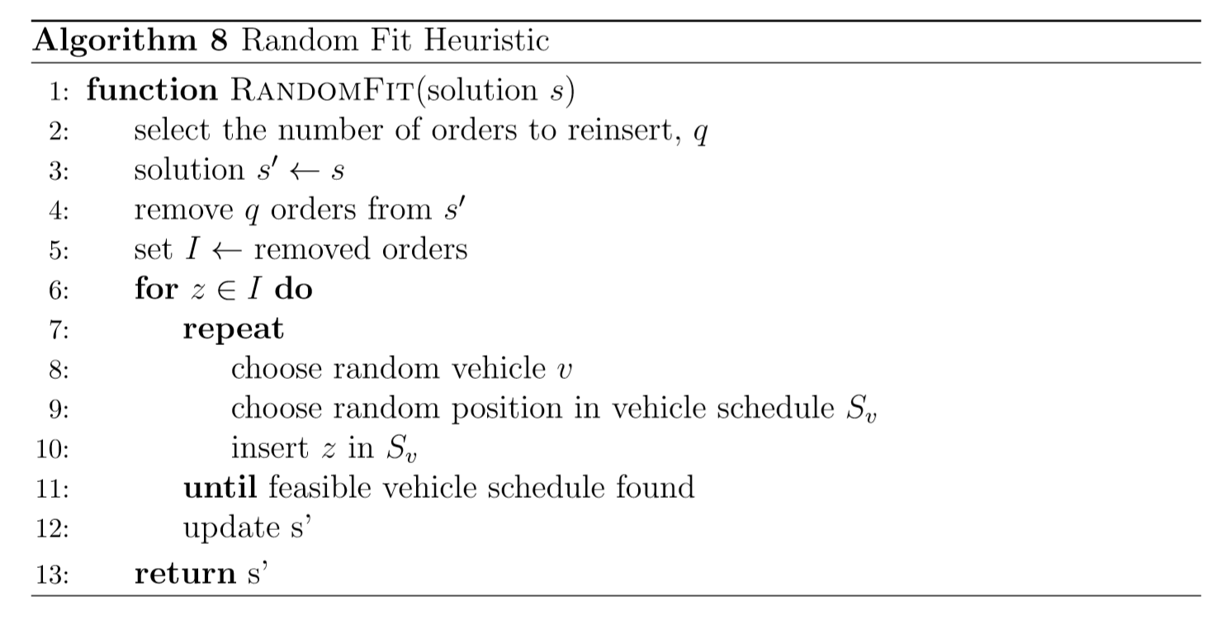
4th Party Logistics Optimizer
Heuristics – Random Fit
Motivation → Problem → 4PLO → Experiments → Conclusions

Slide 56
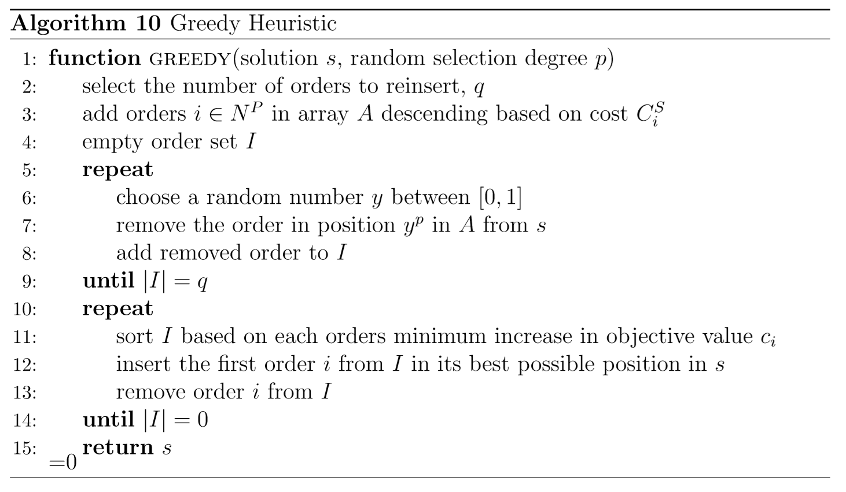
4th Party Logistics Optimizer
Heuristics – Greedy
Motivation → Problem → 4PLO → Experiments → Conclusions

Slide 57
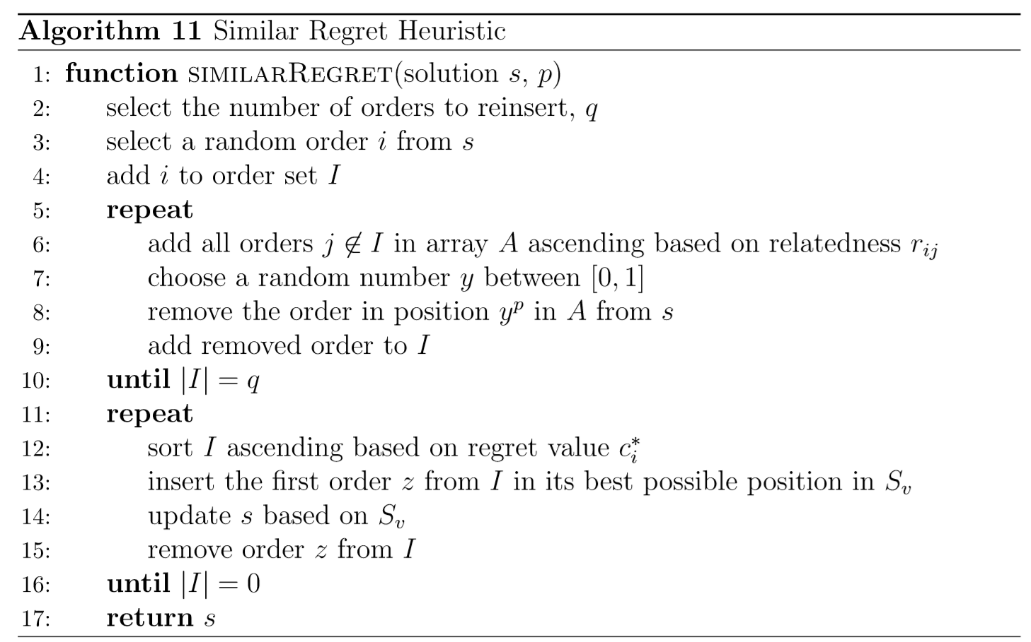
4th Party Logistics Optimizer
Heuristics – Similar Regret
Motivation → Problem → 4PLO → Experiments → Conclusions

Slide 58
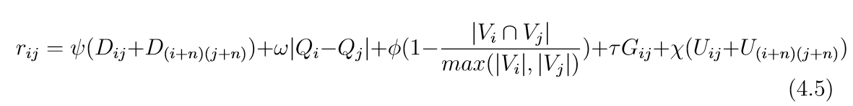
4th Party Logistics Optimizer
Heuristics – Similar Regret
Relatedness factor:
Distance, weight, vehicle compatability, factory, timewindow overlap.
Insertion is based on a regret value trying to improve the greedy version
Motivation → Problem → 4PLO → Experiments → Conclusions

Slide 59
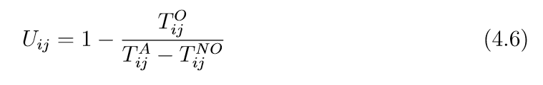
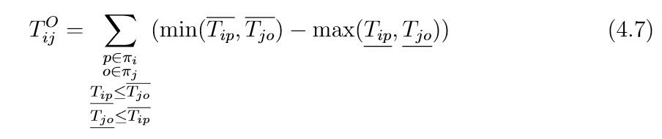
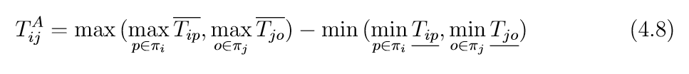

Time windows overlap
Factor:
Overlap:
Span:
No Overlap:

Slide 60

Time windows overlap

Slide 61

Appendix A
Results when including all heuristics on instance Set 1 (Europe)

Slide 62
Solution Methods
Branch-and-bound
Setting a bound to a search to avoid abundant search
Morrison et al. (2016) survey of recent research advances in design of branch-and-bound
Will return optimal solution value
Motivation → Problem → 4PLO → Experiments → Conclusions

Slide 63
Solution Methods
Branch-and-cut
Combination of branch-and-bound and cutting planes method which further cuts away infeasible solutions for more efficiency.
Qiu et al. (2018) for further details
Will return optimal solution value
Motivation → Problem → 4PLO → Experiments → Conclusions

Slide 64
Solution Methods
Branch-and-price
Combination of branch-and-bound and cutting planes method which further cuts away infeasible solutions for more efficiency.
Qiu et al. (2018) for further details
Will return optimal solution value
Motivation → Problem → 4PLO → Experiments → Conclusions

